Slide 1
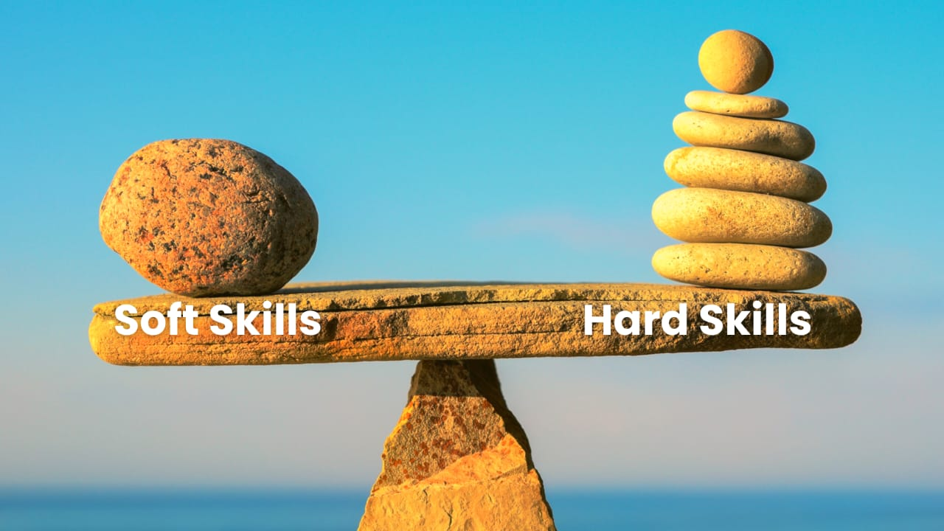
Harnessing Human Potential: The Equal Importance of Soft and Hard Skills
1. Introduction
1.0 – Opening Hook + Personal Introduction
1.1 – Amazing Fact
1.2 – Why Topic Matters
2. Breakdown of Key Concepts
2.1 – What are Soft Skills?
2.2 – What are Hard Skills?
2.3 – Differences Between Soft & Hard Skills
3. Main Body – Soft Skills in Today’s World
3.1 – Why Soft Skills Are Rising
3.2 – Evidence from Research
3.3 – How Companies Use Soft Skills
4. Takeaway – Most Important Idea
4.1 – Key Takeaway
Made by: Ivan Lunevskiu Rodion Matvieiev

Slide 2

An Amazing fact

Slide 3
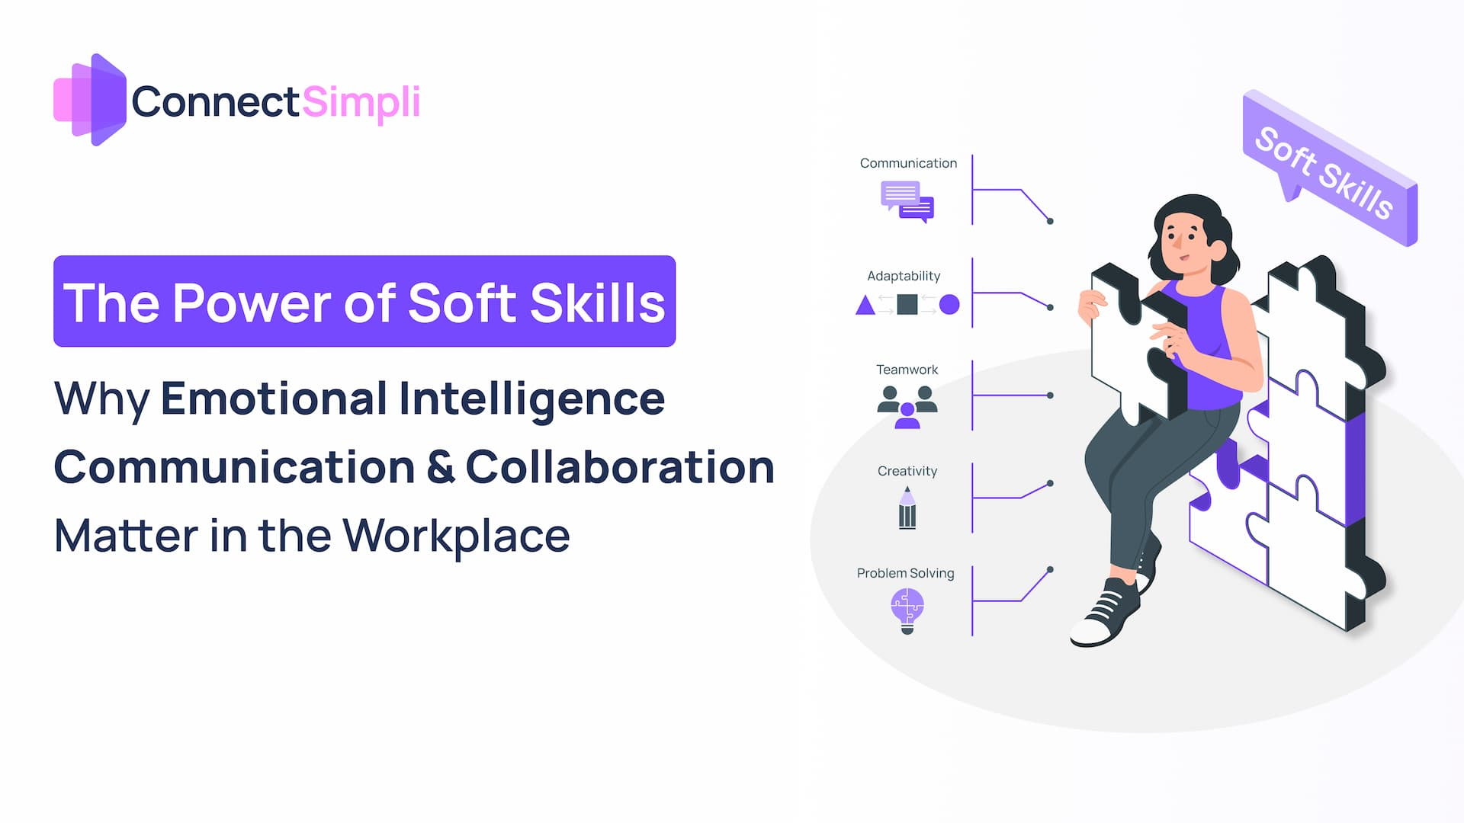
Soft skills allow us to harness the power of collaboration

Slide 4
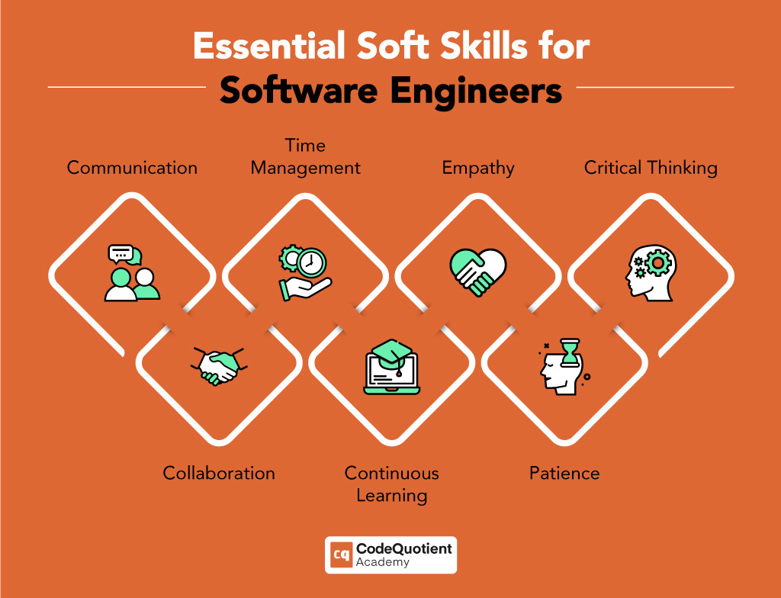
What are the soft skills ?

Slide 5
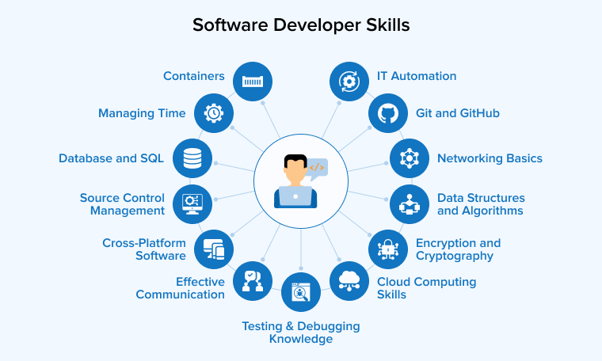
What are the hard skills?

Slide 6


Slide 7
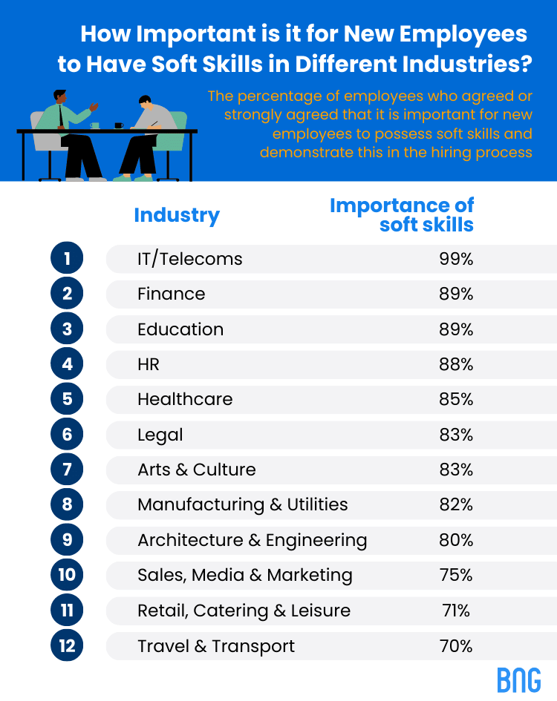
Why soft skills are rising in importance?

Slide 8
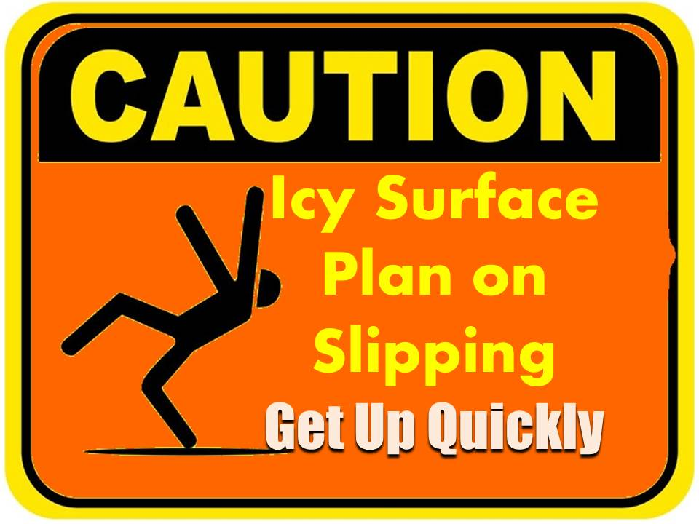
Thank you! Step up your game, harness your potential, and never let your soft skills flop!

